Slide 1
Facial Emotion Recognition
Liangyu Wang

Slide 2
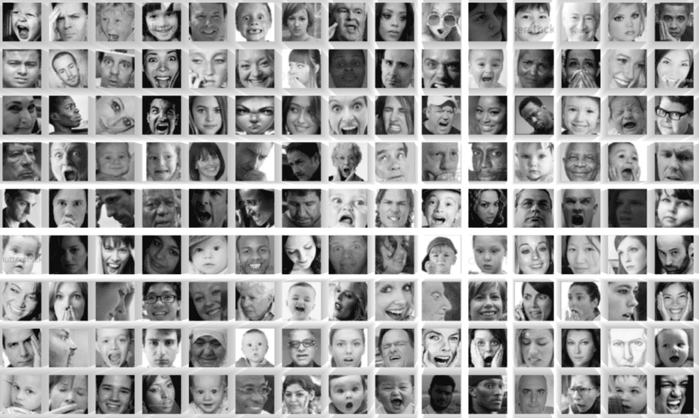
Introduction
Facial emotion recognition holds significant importance in various business contexts due to its potential impact on customer experience, employee well-being, and overall business performance.
Gauge customer reactions to products, services, or advertisements.
Facial emotion recognition can help businesses assess customer satisfaction levels in real time.
Businesses that prioritize employee well-being often leverage facial emotion recognition to monitor and assess the emotional states of their workforce.

Slide 3
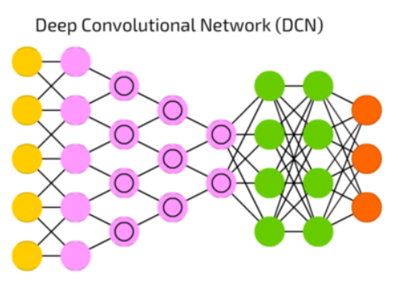
Objective
1
Train traditional machine learning models to classify facial emotions
2
Train a convolutional neural network to classify facial emotions
3
Compare results

Slide 4

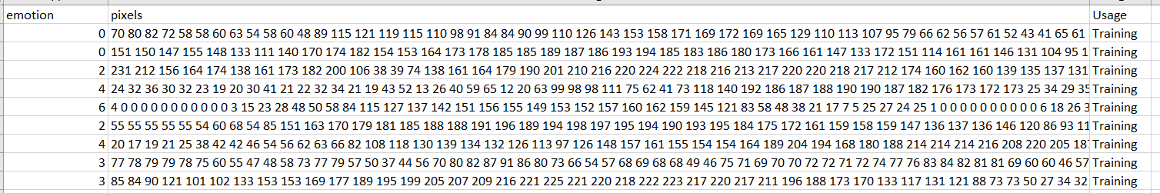
Data
Fer2013 Dataset:
A collection of 35887 labeled images of people’s facial expressions.
Source: https://www.kaggle.com/datasets/ashishpatel26/facial-expression-recognitionferchallenge/data

Slide 5
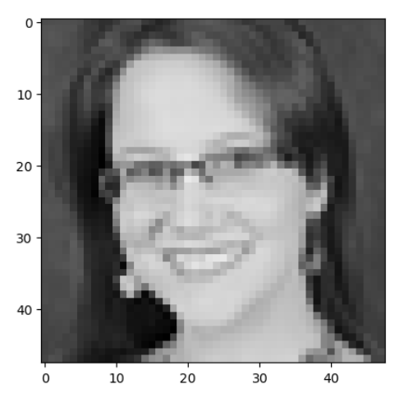
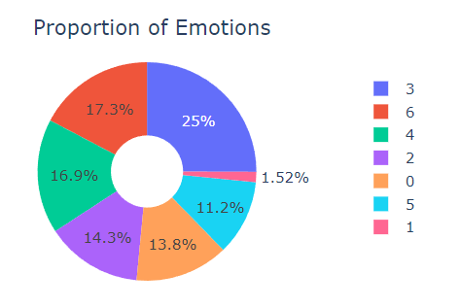
Data
48 x 48 pixels = 2304 features
Source: https://www.kaggle.com/datasets/ashishpatel26/facial-expression-recognitionferchallenge/data

Slide 6
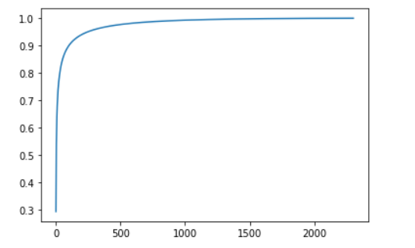
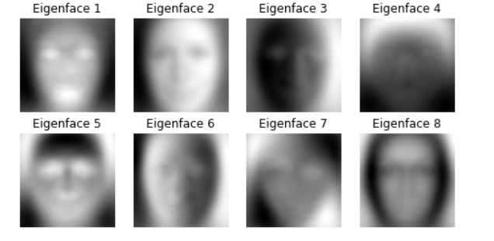
Principal Component Analysis
2304 Feature
253 Feature

Slide 7
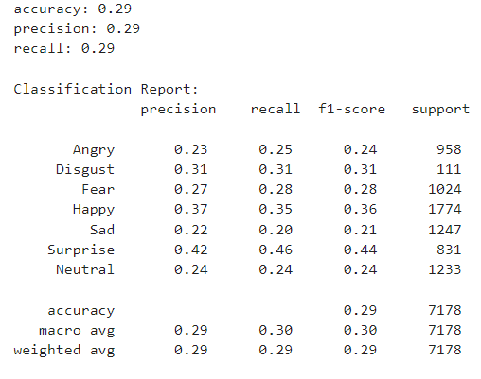
Decision Tree Classifier
DecisionTree Classifier is choosen as base model because it can do multi-label classification.

Slide 8
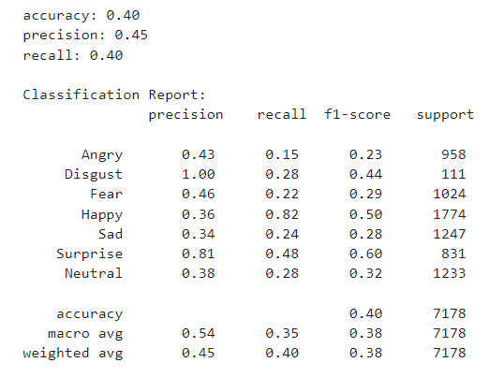
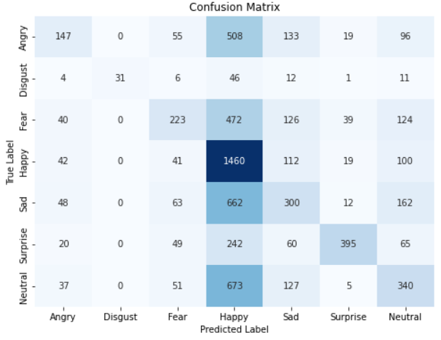
Random Forest Classifier
Random Forest is another machine learning algorithm that can do multi-label classification.

Slide 9
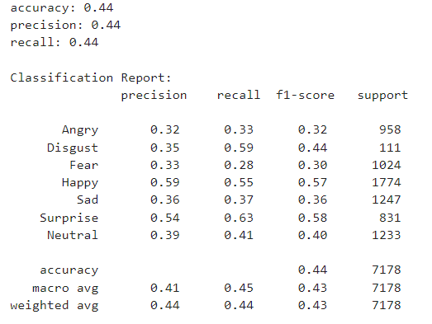
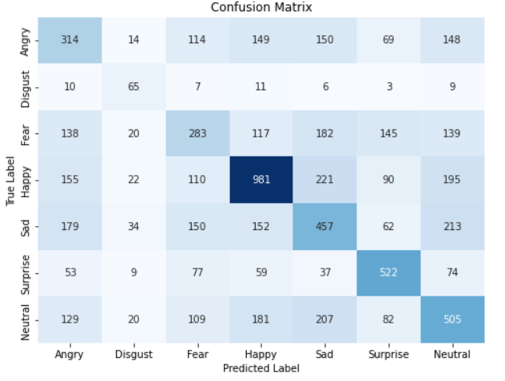
SVM Classifier
Sklearn’s SVM algorithm supports multi-label classification.

Slide 10
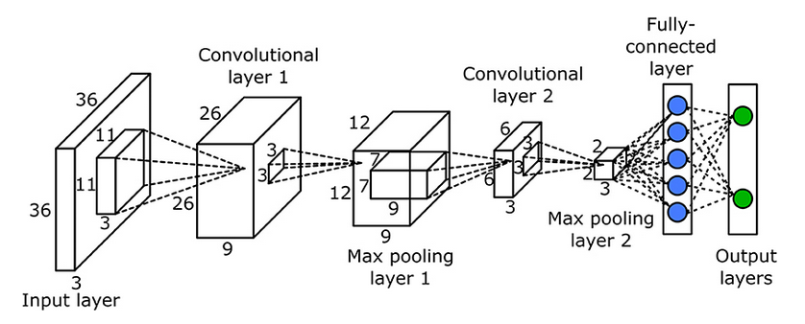
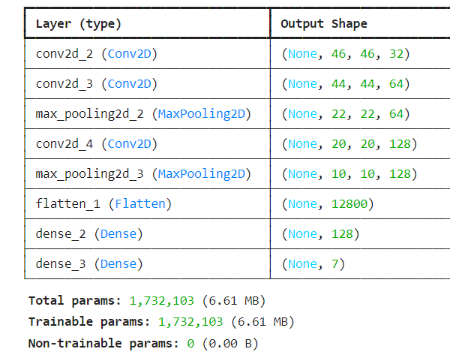
Convolutional Neural Network

Slide 11
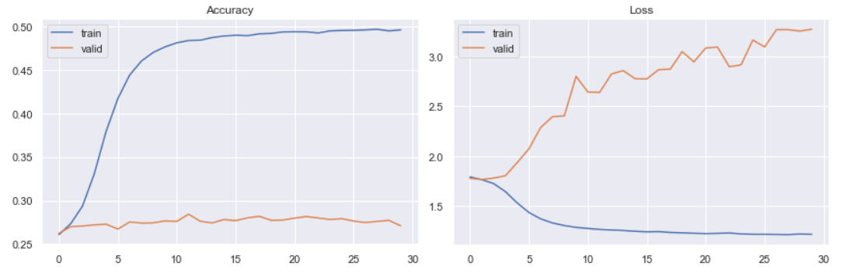
Convolutional Neural Network

Slide 12
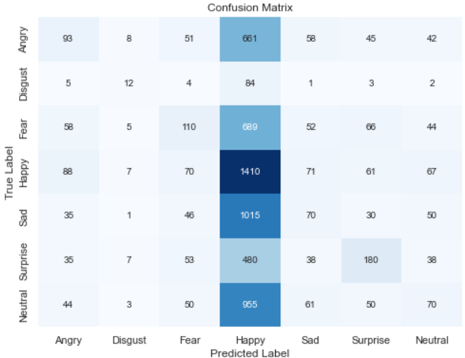
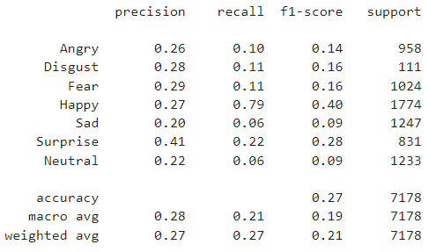
Convolutional Neural Network
The neural work seems to overwhelmingly predict emotion to be "happy" which happens to be the class with the highest number of samples.

Slide 13
Challenges
1
Dataset is imbalanced, some emotions have too little sample. Upsampling the dataset doesn’t improve accuracy.
2
Increase accuracy of convolutional neural network without over-fitting.

Slide 14
Conclusions
Traditional machine learning algorithms like support Vector Machine achieves better result than Convolutional neural network for facial emotion recognition.

Slide 15
Next Step
We can try other neural network architectures such as Transfer Learning, VGGnet, Residual Network to achieve more accurate predictions.

Slide 16
Thank You!

